Slide 1
Deliverable 02
Abhinav Konagala, Mykiah Ashley, Kuran Chona

Slide 2
Requirements Definition
AIM: UMBeats is a DJ club that brings together people who enjoy the creation of music, building a community of DJ’s, musicians, producers, teachers, and students who convey themselves through music. The goal of this project is to increase sales and develop an online interface accessible through social networking websites such as Facebook and Twitter. We will be conducting surveys to improve customer satisfaction.

Slide 3
Requirements Definition Cont.
FUNCTIONAL REQUIREMENTS:
Process-oriented:
The system will allow customers to view event details on the social networking sites.
The system will allow customers to make suggestions about their music styles and music preferences through email system.
The system will record customers answers to online surveys and music personality quiz.
The system will select DJ’s based on music event rather than on availability.

Slide 4
Requirements Definition Cont.
Process-oriented cont.
The system will allow the customers to view their DJ’s reviews.
The system will record customer payment.
The system will create a event ticket when a customer books an appointment.
The system will allow the customer to cancel their appointment 48 hours in advance.
The system will send each customer a 24 hour reminder for the event.

Slide 5
Requirements Definition Cont.
Information-oriented:
The system must contain all the requests made by customers through online surveys and music personality quizzes.
The system must contain all the information about the DJ performers and the music style they perform.
The system must store a record of the users past DJ choices for a minimum of 2 years.
The system must maintain an active list of DJ’s.
The system must contain each DJ’s availability for the month.

Slide 6
Requirements Definition Cont.
Information-oriented:
The system must contain a review of each DJ.
The system must maintain a customer payment log.
The system must maintain a communication medium between customers and their selected DJ.

Slide 7
Requirements Definition Cont.
NONFUNCTIONAL REQUIREMENTS
Operational:
The system must have backup equipment in case of hardware failure.
The surveys and music personality quizzes should run on any browser.
The online interface will run of iOS and Android systems.

Slide 8
Requirements Definition Cont.
NONFUNCTIONAL REQUIREMENTS
Performance:
The online survey should not exceed more than 3 minutes.
The music personality should not exceed more than 2 minutes.
The answers to the survey must be limited to one choice per question.
The DJ’s availability must be updated every hour and removed instantly when selected by a customer.
The system must be able to respond to customer requests on priority based.

Slide 9
Requirements Definition Cont.
NONFUNCTIONAL REQUIREMENTS
Security:
Only event managers must have authorized access to the event requests.
Only event managers can manage and view DJ’s personal information.
Customer payment information must be safeguarded and accessed only by managers.

Slide 10
Requirements Definition Cont.
NONFUNCTIONAL REQUIREMENTS
Cultural:
The system must be open-minded about performing different music styles at the events.
The system should select DJ’s according to the requested music event style.

Slide 11
Interview Schedule:
NAME | POSITION | PURPOSE OF INTERVIEW | MEETING
Andrew Jefferson | Treasurer/ DJ | To gain a better perspective of how the organization works. | Fri, March 09 5:00 - 7:00 P.M.
Justin Milton | President/ DJ | To question the president and determine how the organization does work | Fri, March 09 5:00 - 7:00 P.M.
Matt Vermont | Vice President/ DJ | To analyze the differences between the president and vice President | Fri, March 09 5:00 - 7:00 P.M.
Quentin Jones | Performer | To understand a performer’s point of view | Fri, March 09 5:00 - 7:00 P.M.
Nick Spears | Lead Audio Engineer | To understand different views from different members in the company. | Fri, March 09 5:00 - 7:00 P.M.

Slide 12
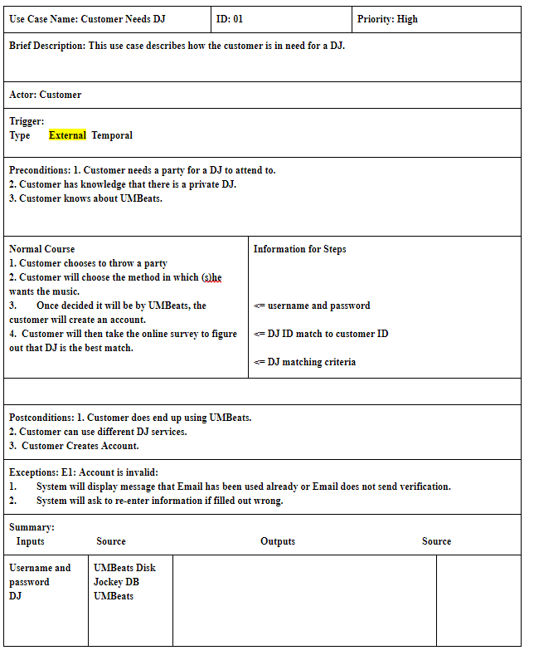
Use Case Analysis

Slide 13
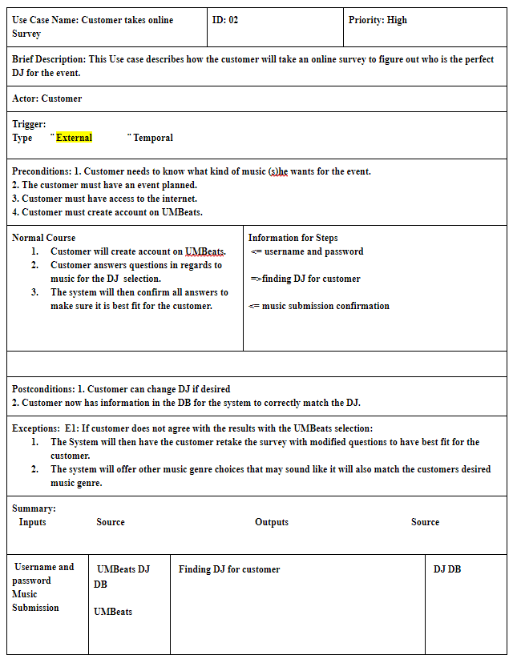
Use Case Analysis Cont.

Slide 14
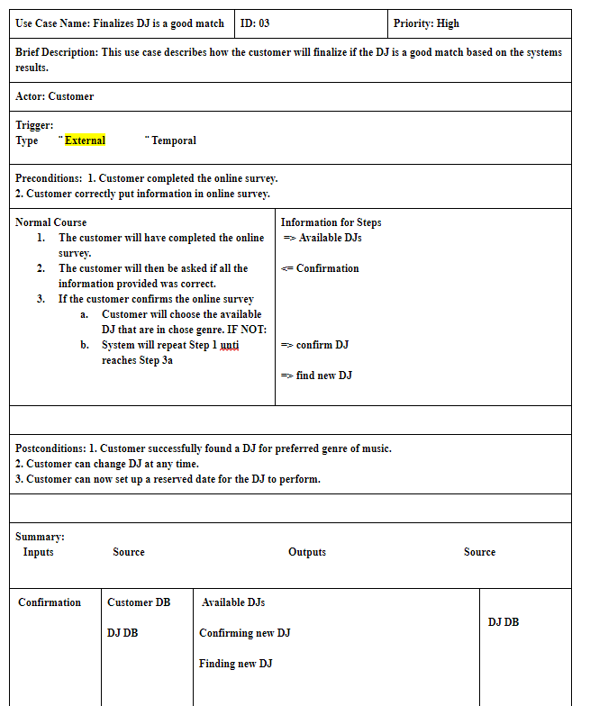
Use Case Analysis Cont.

Slide 15
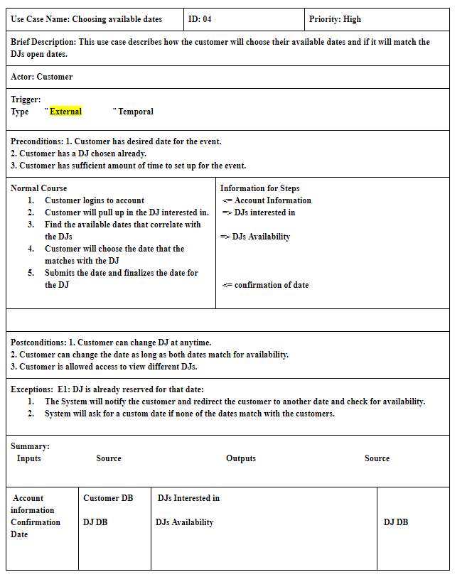
Use Case Analysis Cont.

Slide 16
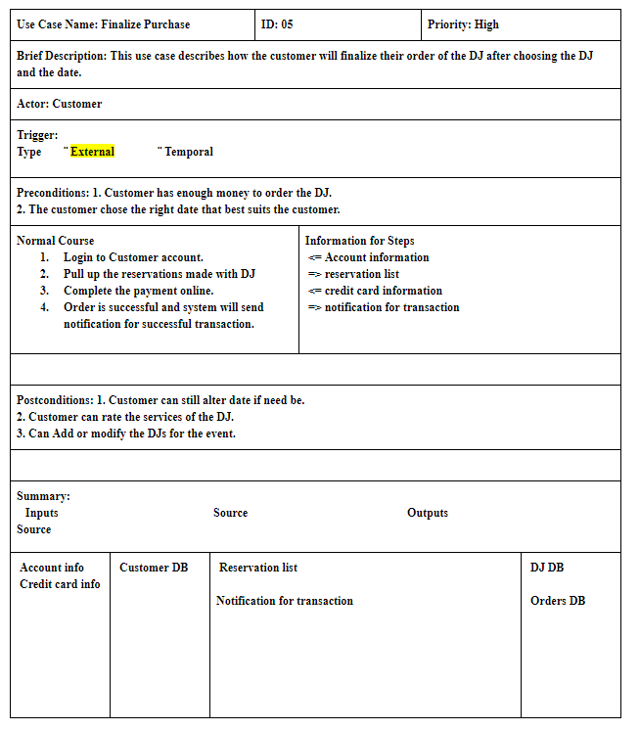
Use Case Analysis Cont.

Slide 17
Thank you
Any Questions?

